Slide 1

When2Work
Scheduling Software
Click to Begin

Slide 2
Error!
Please follow the on-screen
instructions to continue.
Go Back

Slide 3
Complete
Please navigate to the next module
in the course to continue.
Restart Course

Slide 4
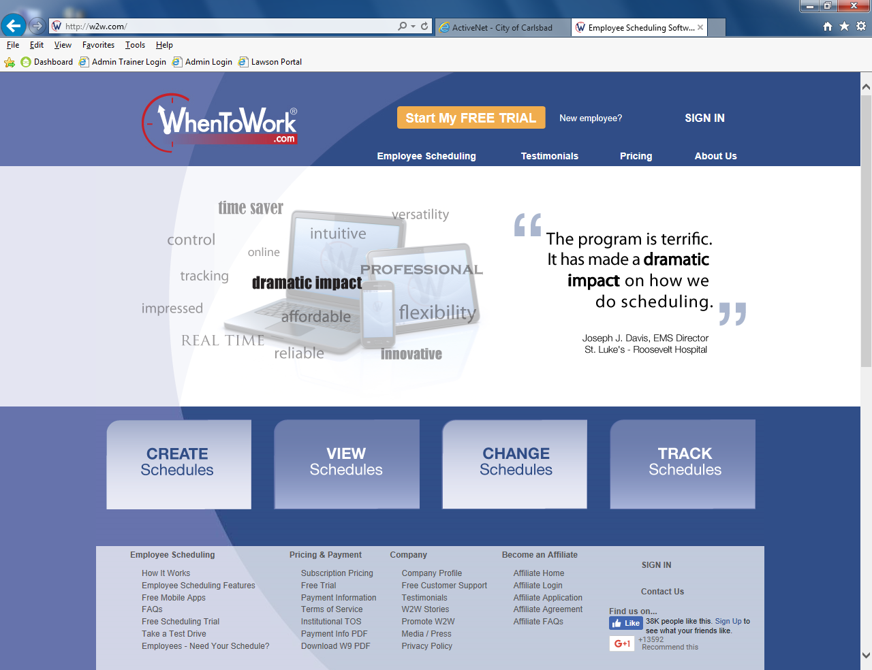
Click to
Sign In
Tip:
Welcome to When2Work
Your Employee Scheduling System

Slide 5
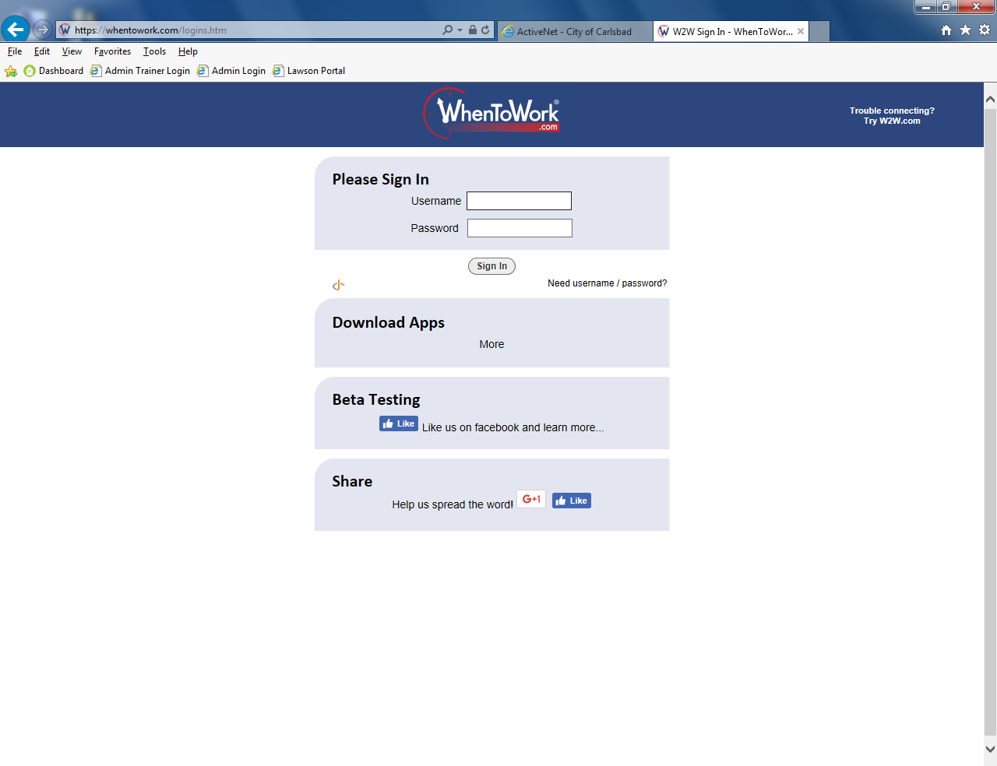
Tip:
Login using your provided username
You should have received an email from W2W

Slide 6

Tip:
Use your password to login
You will be asked to change it at a later point in time.

Slide 7
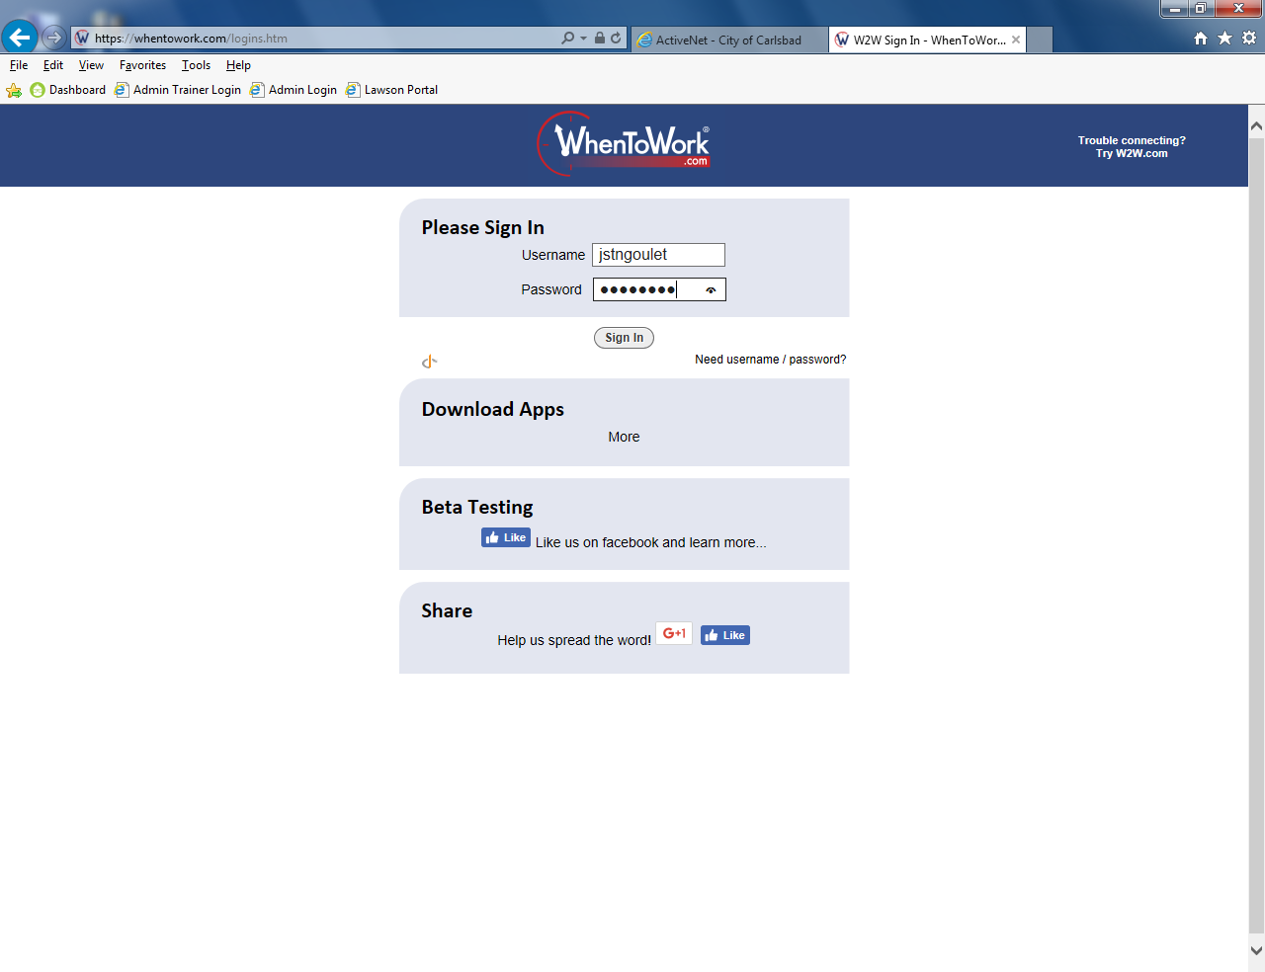
Tip:
Press ‘Return’ or click to sign in
You may verify you typed the password correctly by clicking the symbol to the right of the password field.

Slide 8
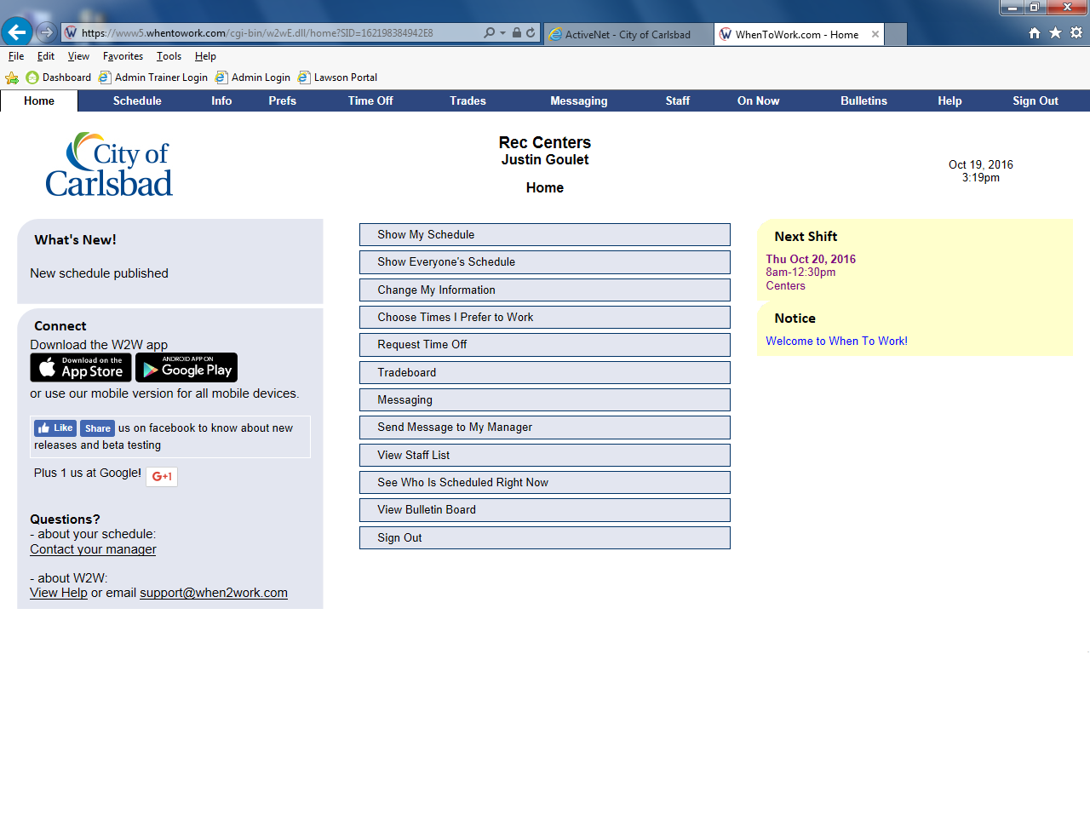
Navigate this tutorial by selecting options from the highlighted area
Tip:
When2Work Main Menu
Select an item from the list to check it out!

Slide 9
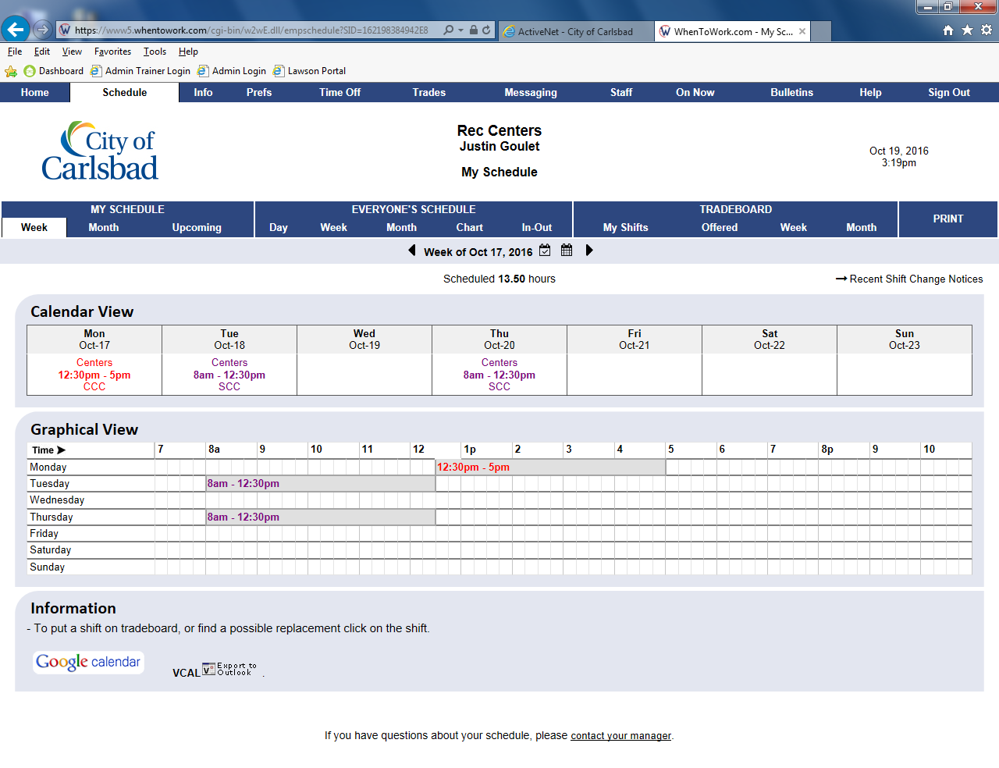
Tip:
Back
Finish
Your Schedule Appears Here
The default is a single week view. Different Schedules offer different views.

Slide 10
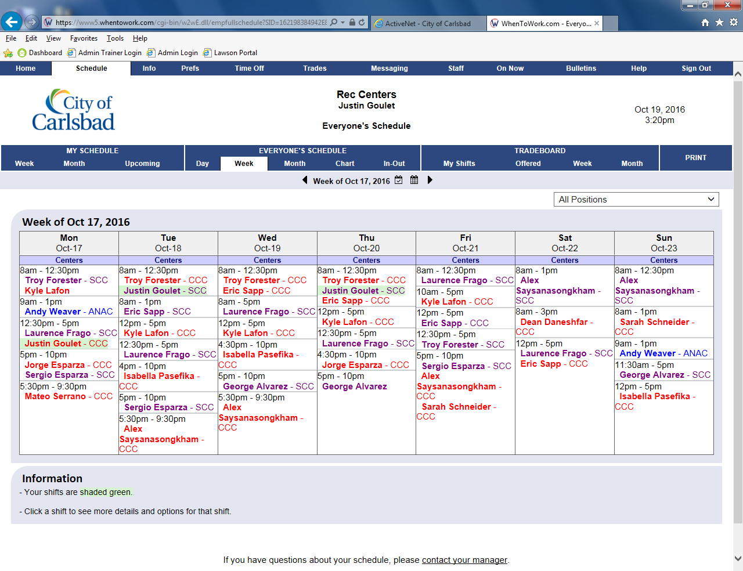
Tip:
Back
Finish
This is Everyone’s Schedule
Here, you can see who is working for a full week.

Slide 11
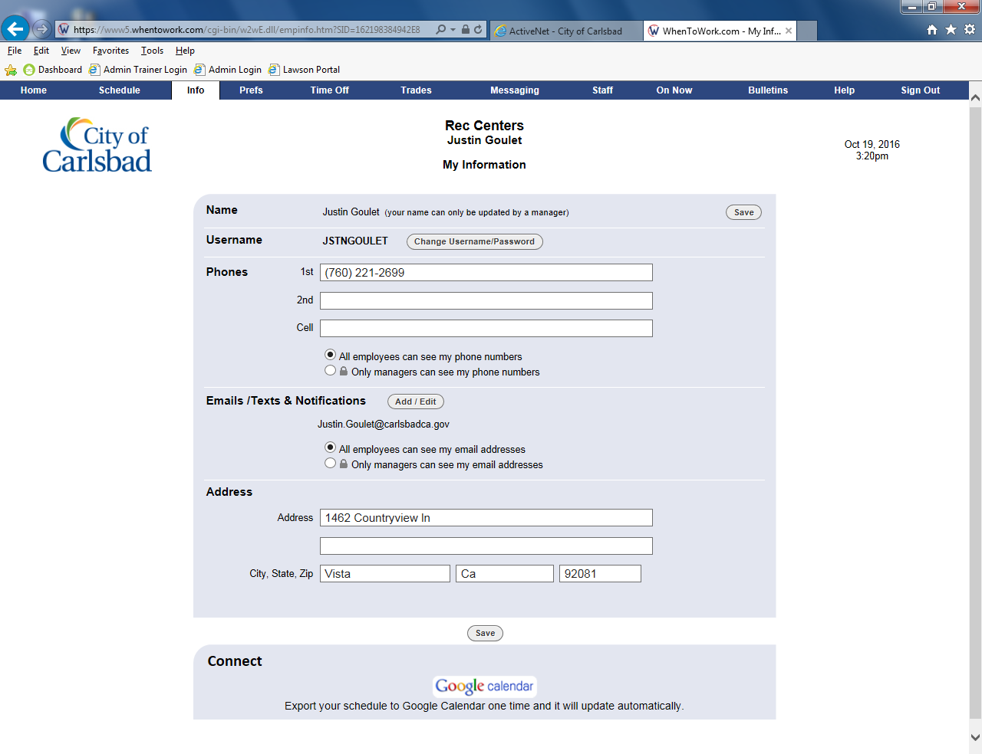
Tip:
Back
Finish
Edit your information
This page allows you to manage your contact information

Slide 12
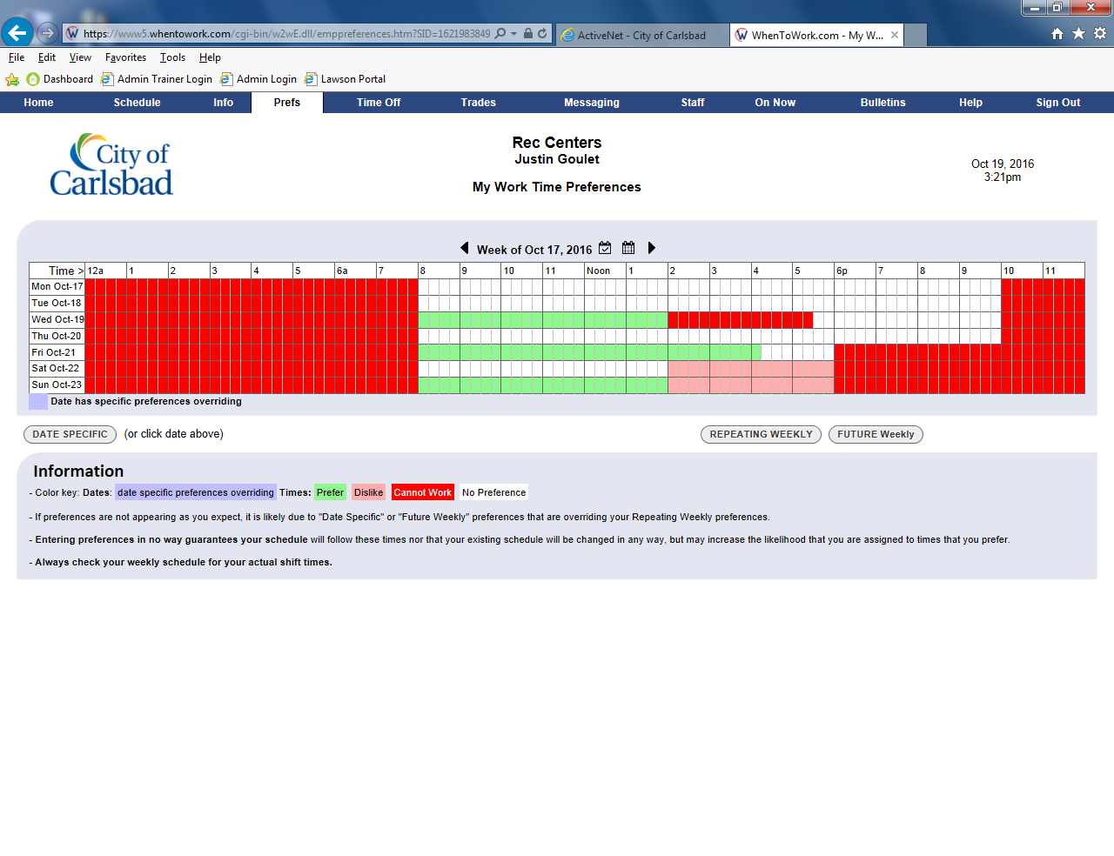
Tip:
Back
Finish
Change your availability
Adjusting your availability will let your manager know when you can work

Slide 13
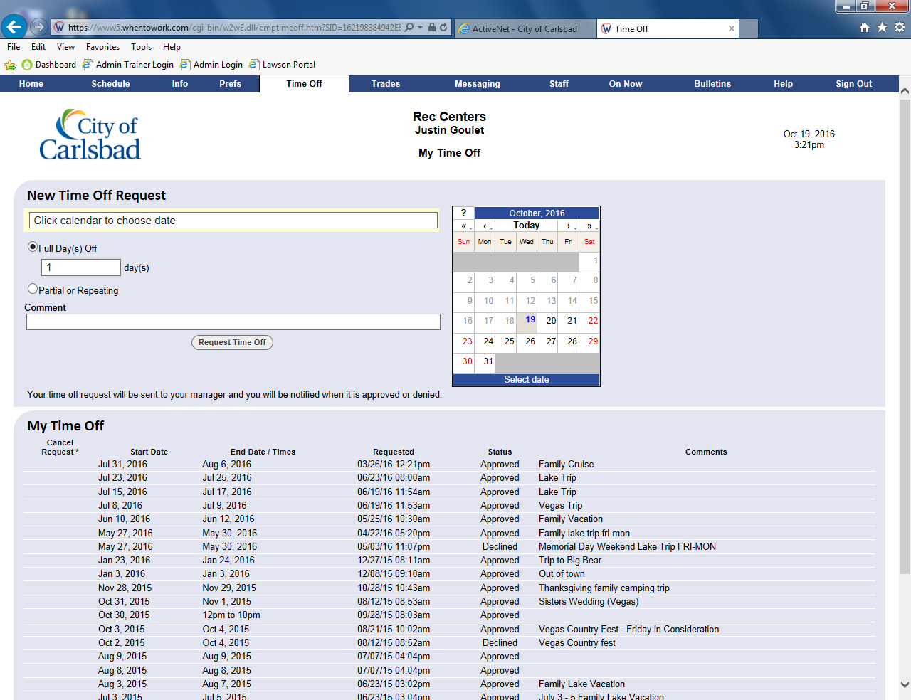
Tip:
Back
Finish
Request Time Off
Let your manager know you are going away to request time off.

Slide 14
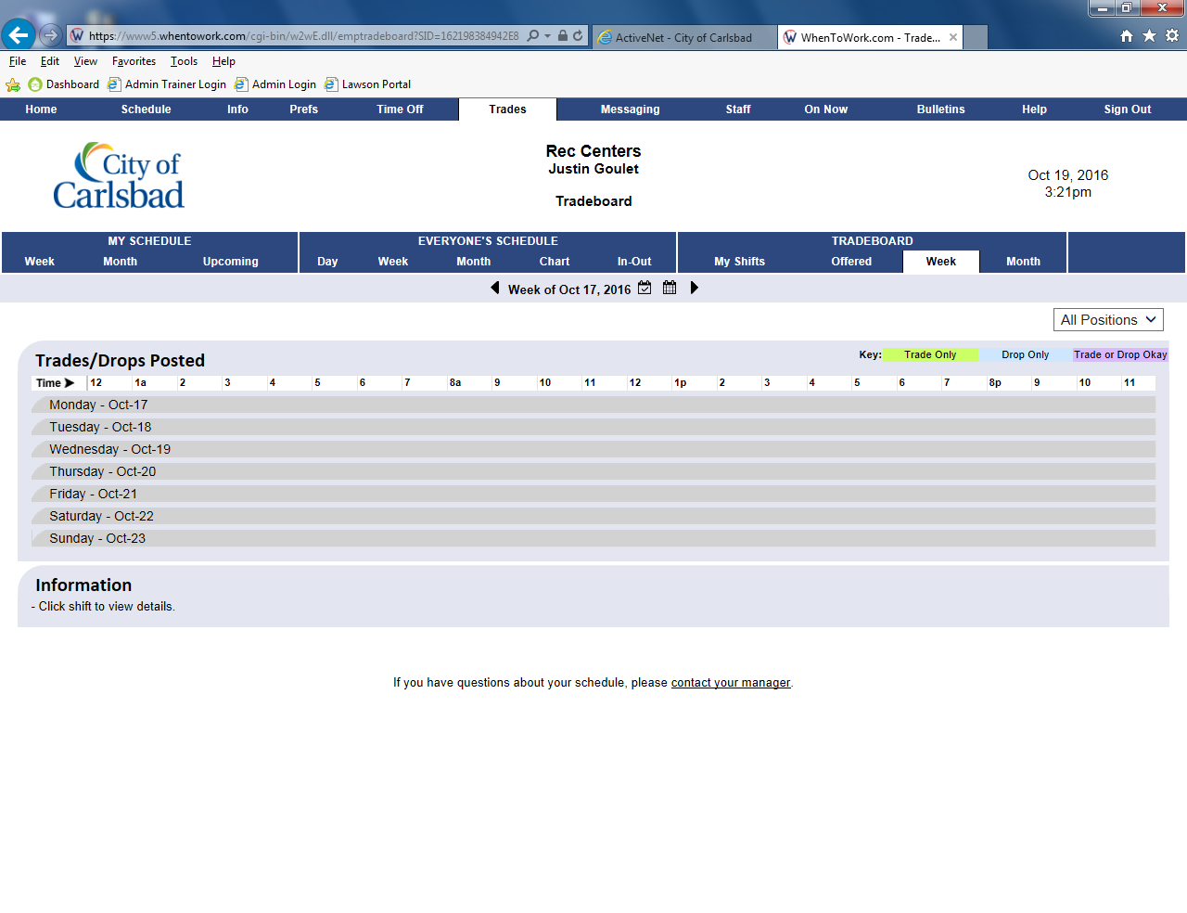
Tip:
Back
Finish
View available shifts
Your peers may be looking to trade shifts with you.

Slide 15
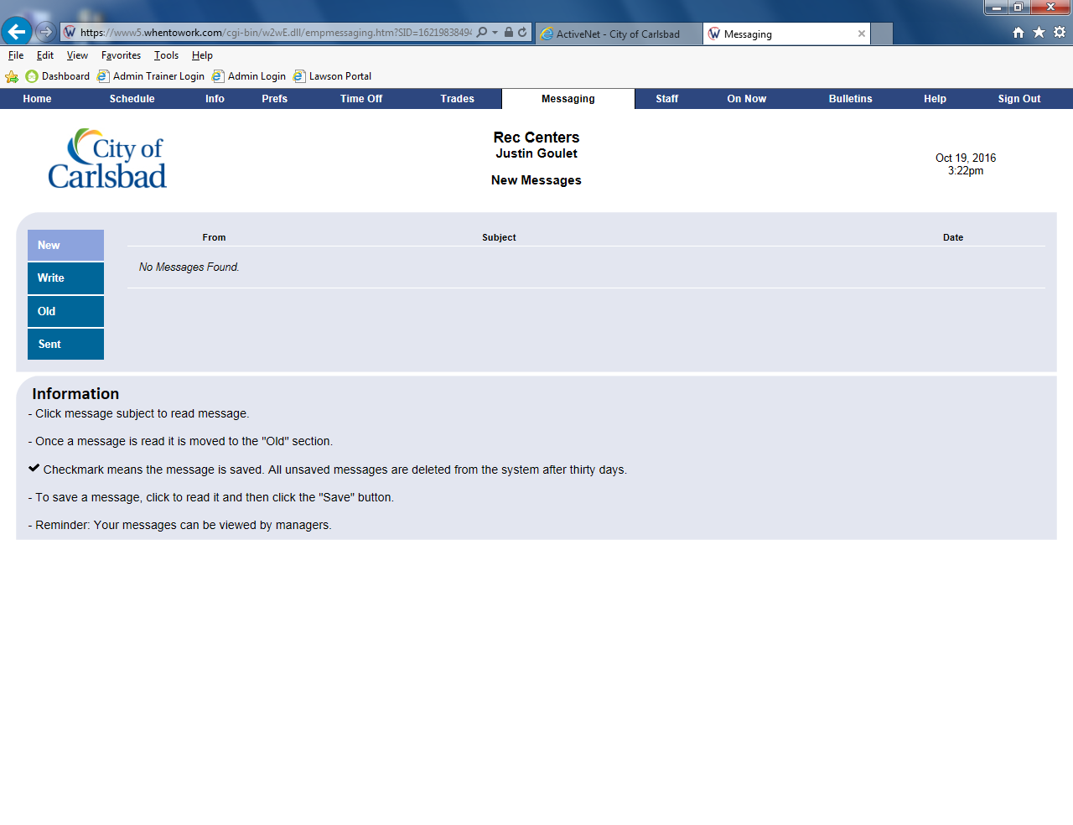
Tip:
Back
Finish
Send a Message to a colleague
You may send a message to a coworker or manager.

Slide 16
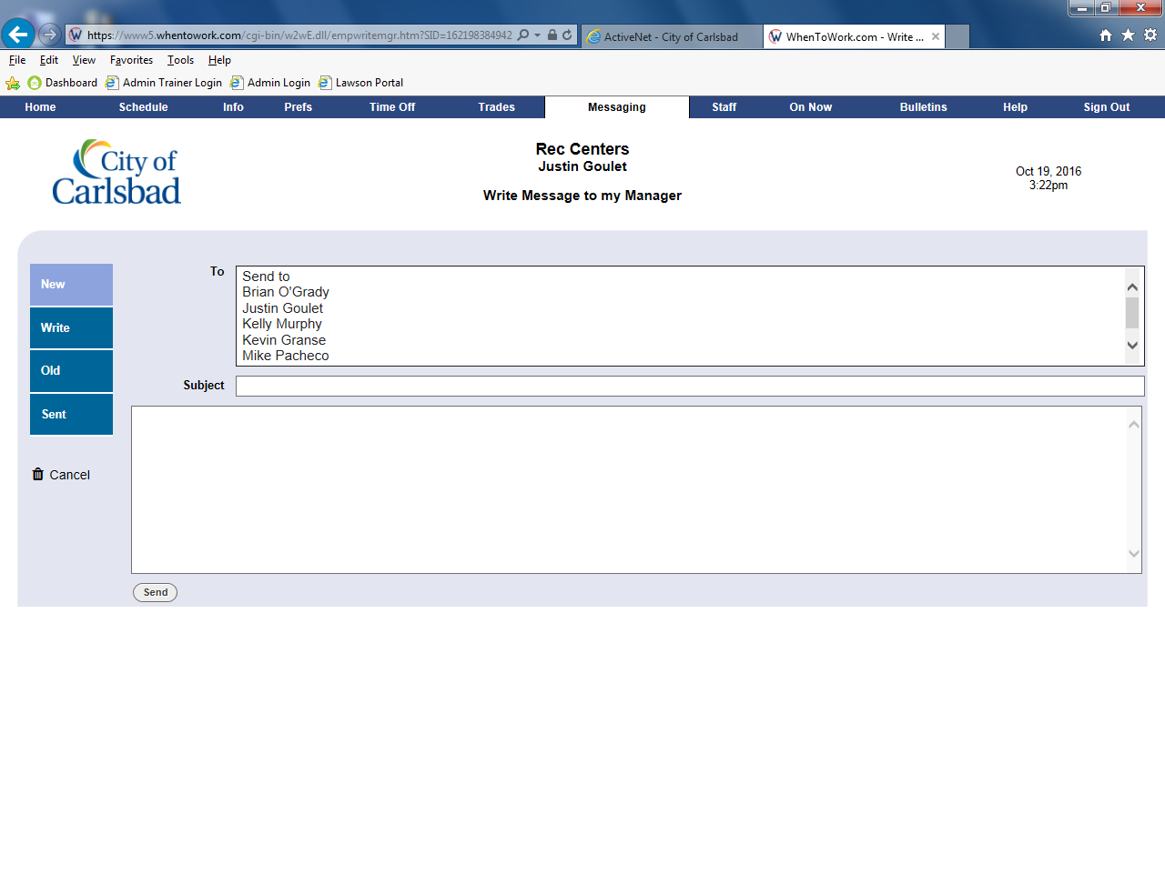
Tip:
Back
Finish
Send a message to your manager
Select who you wish to send it to then add a note.

Slide 17
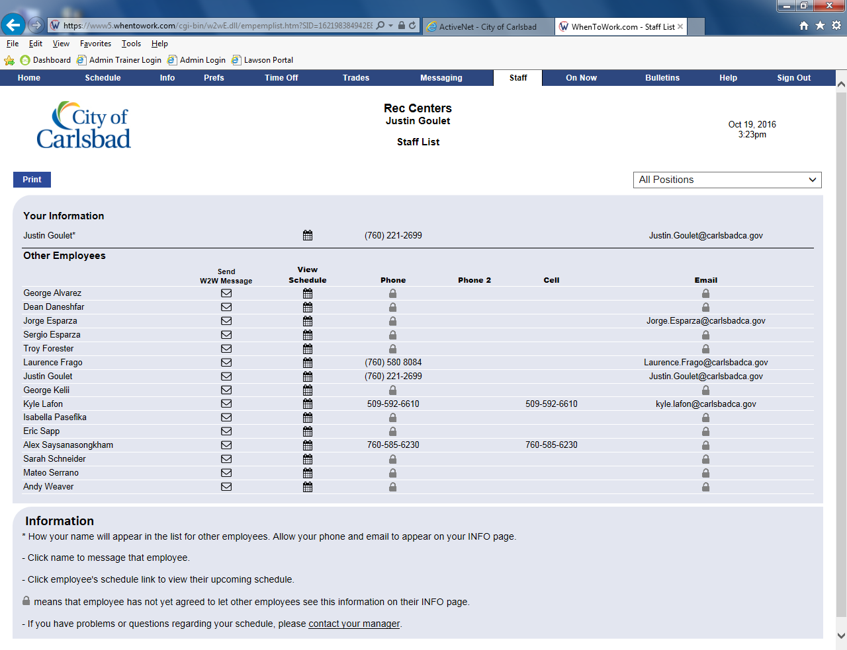
Tip:
Back
Finish
View all staff who share your work
You may send them a message here, too, and see the phone numbers of those who chose to have it public.

Slide 18
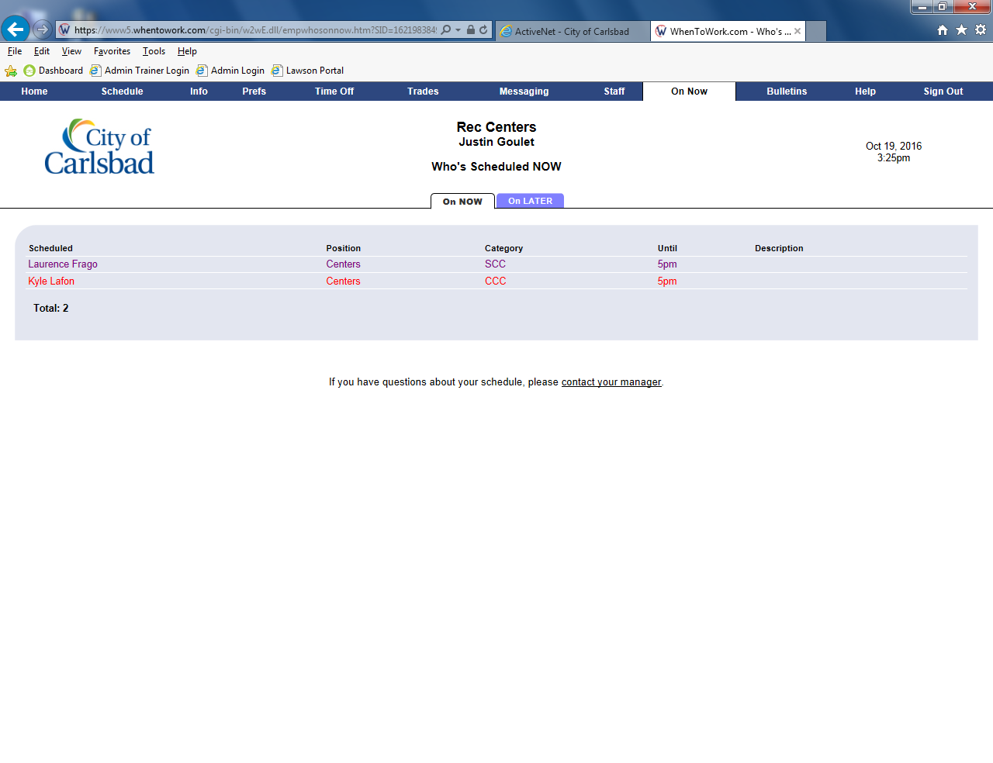
Tip:
Back
Finish
See who is currently scheduled
You may see who is scheduled and their time of completion.

Slide 19
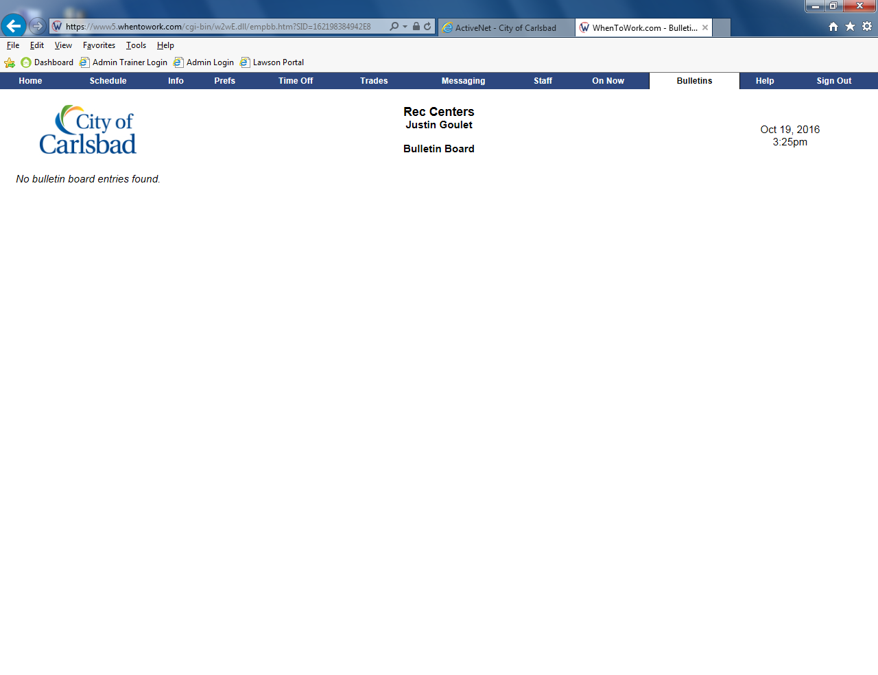
Tip:
Back
Finish
View messages posted by your supervisor
These may be quick alerts to inform you of critical information

